Slide 1
Stroke Predictions
March 2022

Slide 2
Agenda
Background
Data Dictionary
Data Cleaning
Exploratory Data Analysis (EDA)
Next Steps

Slide 3
Background
According to the World Health Organization (WHO), stroke is the 2nd leading cause of death globally. It is responsible for approximately 11% of total deaths.
The dataset provided will be used to predict whether a patient is likely to get a stroke based on numerous factors.
This dataset was found on Kaggle and will be available upon request.

Slide 4
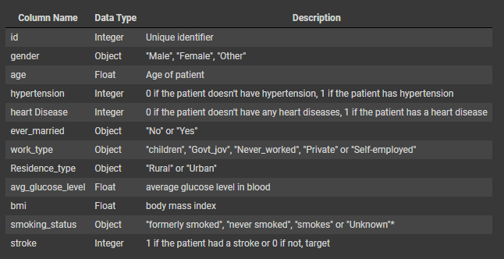
Data Dictionary
*Note: "Unknown" in smoking_status means that the information is unavailable for this patient

Slide 5
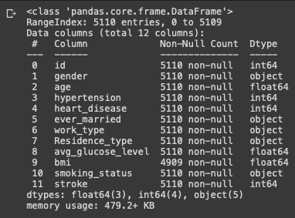
Data Cleaning
I checked for missing values using the code df.duplicated().any()
No duplicates were found in the data.
I explored the data using df.info() and saw that bmi has missing values. This will be addressed using a median imputer when I preprocess the data for Machine Learning models.

Slide 6
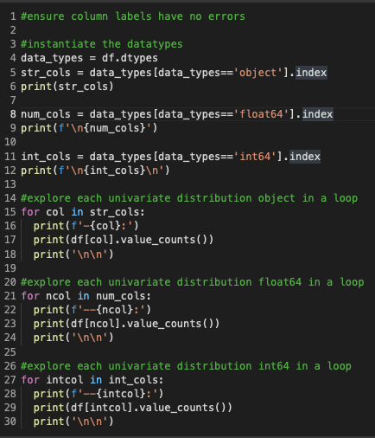


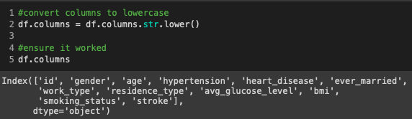
Data Cleaning
While ensuring the column labels had no errors, I found 1 ‘other’ in the gender column. This was be dropped.
Residence_type was the only column not fully lowercase. I ensured all columns were lowercase for consistency.

Slide 7
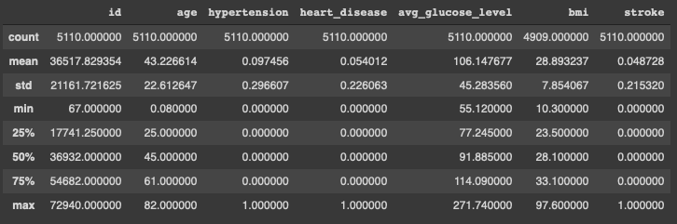
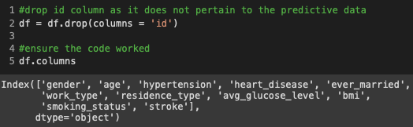
Data Cleaning
Checked statistical data for any inconsistencies.
Dropped id column as it does not pertain to the predictive.

Slide 8
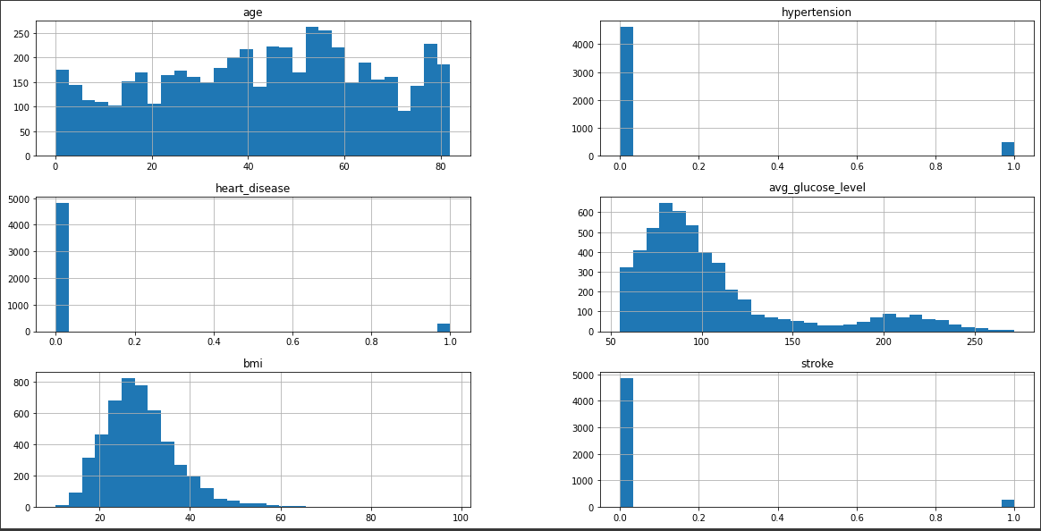
EDA
- Histogram
Age is evenly distributed.
Avg_glucose_level and bmi are skewed to the right, showing a positive distribution.

Slide 9
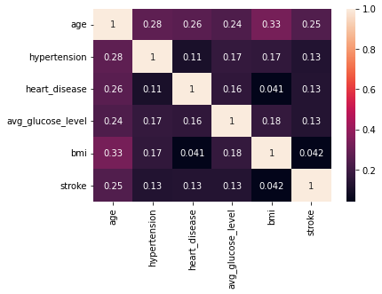
EDA
- Heatmap
Age has correlations to bmi, hypertension, heart_disease, avg_gluclose_level, and stroke.
All categories have a positive correlation to each other.

Slide 10
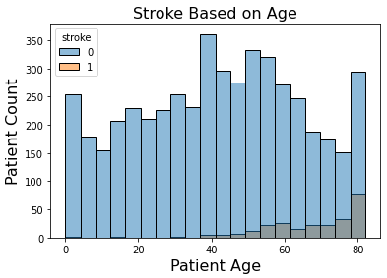
EDA
- Histogram
Chances of stroke increase as you age, but people, according to this data, generally do not have strokes.

Slide 11
Next Steps
Preprocess data for supervised machine learning
Train Test Split
Median Imputer for BMI numerical data
Scaling numerical data
OneHotEncoding object data
Running preprocessed data into categorical models
KNN Classifier
XGBoost
Random Forest Classifier

